Slide 1
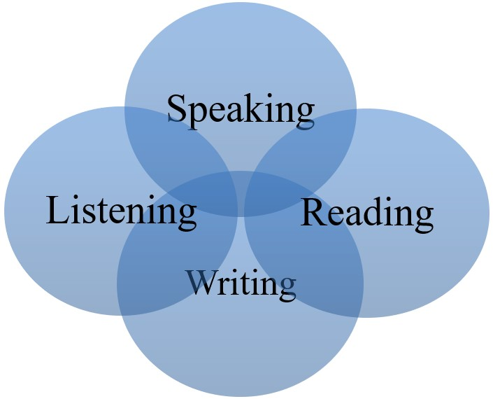
SPEAKING SKILLS

Slide 2

What is Speaking?
Speaking is an act of making vocal sounds. We can say that speaking means to converse, or expressing one's thoughts and feelings in spoken language. To speak often implies conveying information. It may be from an informal remark to a scholarly presentation to a formal address.

Slide 3
Speaking Skills
Speaking skills are the skills that give us the ability to communicate effectively.
These skills allow the speaker, to convey his message in a passionate, thoughtful, and convincing manner.
Speaking skills also help to assure that one won't be misunderstood by those who are listening.

Slide 4
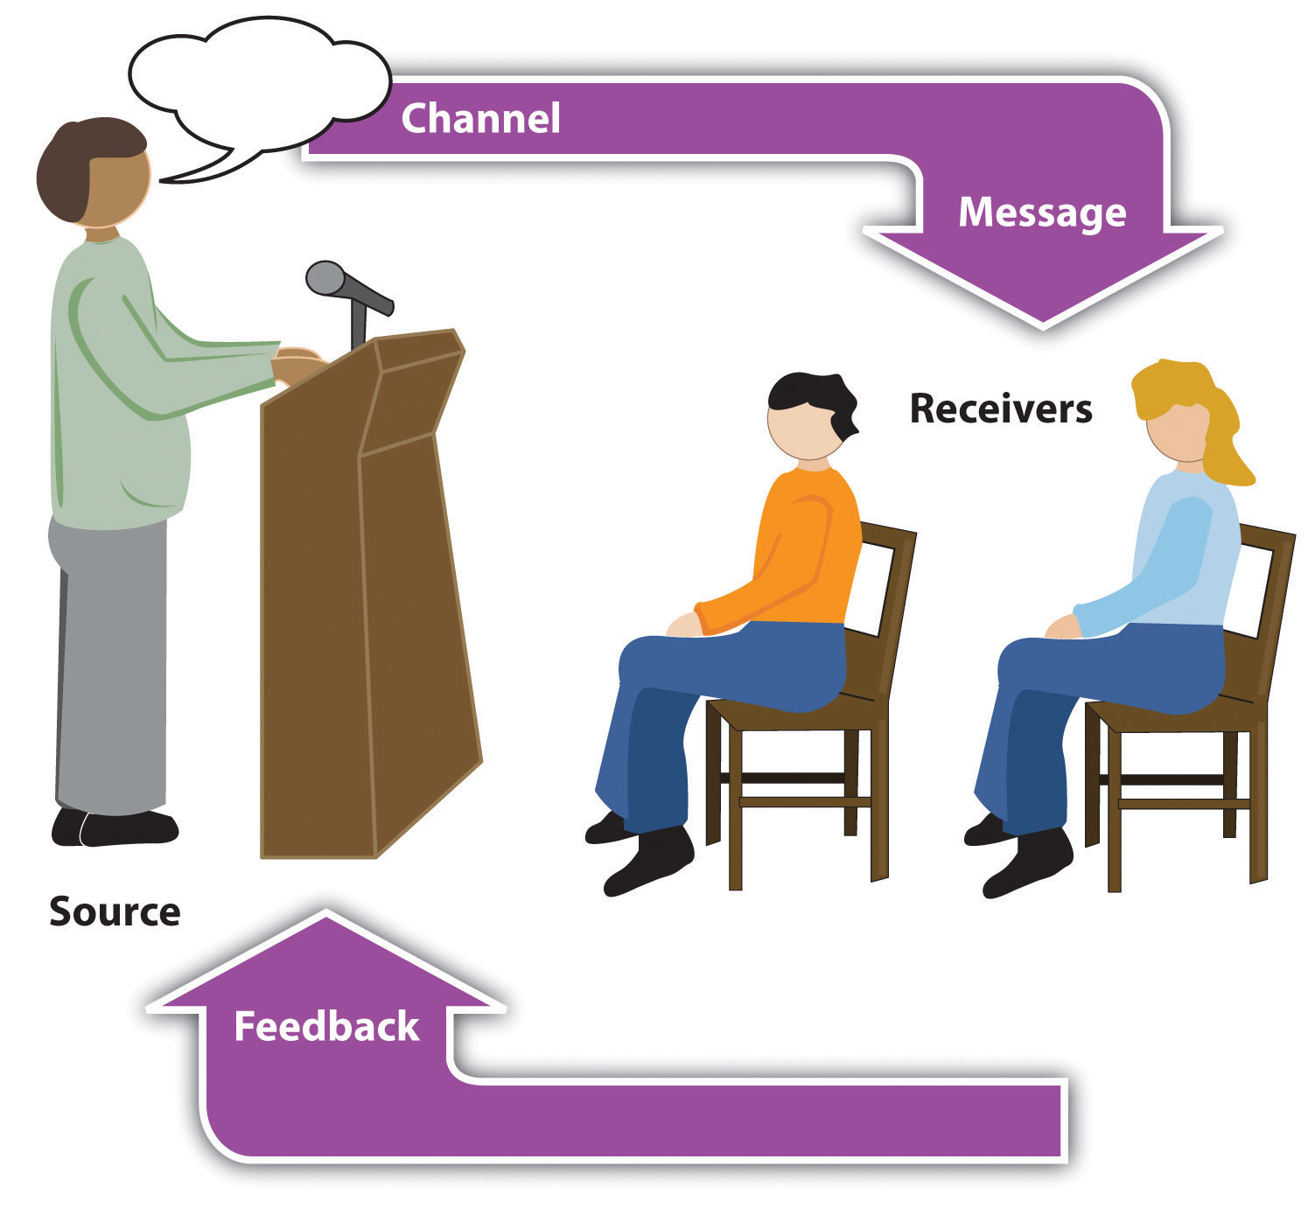

Slide 5
Parts of Speaking
WHAT
WHY
HOW

Slide 6
WHY to Speak?
Not just “presentation”, but also “persuasion”
Get people’s “mindshare”

Slide 7
WHAT to Speak?
Brain storming: Individual Brainstorming is the process of you getting your ideas out on paper
Speaking with the format: IBC :- I- Introduction, B- Body, C- Conclusion
Aiming to persuasion
Being Confident and passionate is the key for persuasion
Clarity of thoughts:

Slide 8
HOW to Speak?
Speak like a STAR
S= Situation
T= Task
A= Attitude
R= Result

Slide 9

Three Es of Speaking
Entertainingly
Effectively
Enthusiastically

Slide 10
Kinds of Speaking Situations we find ourselves in
interactive,
partially interactive, and
non-interactive.
Interactive speaking situations include face-to-face conversations and telephone calls, in which we are alternately listening and speaking, and in which we have a chance to ask for clarification, repetition, or slower speech from our conversation partner

Slide 11
Cont…
Some speaking situations are partially interactive, such as when giving a speech to a live audience, where the convention is that the audience does not interrupt the speech. The speaker nevertheless can see the audience and judge from the expressions on their faces and body language whether or not he or she is being understood.
Some few speaking situations may be totally non-interactive, such as when recording a speech for a radio broadcast.

Slide 12
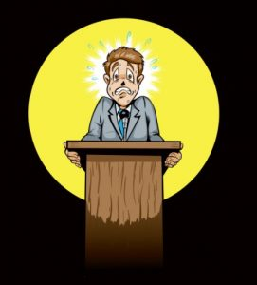
Things You Shouldn’t Do
Reading directly from notes
Turn back on audience
Hands in pockets
No um, ah, you know
No nervous gestures
Talking too fast or talking too quietly

Slide 13
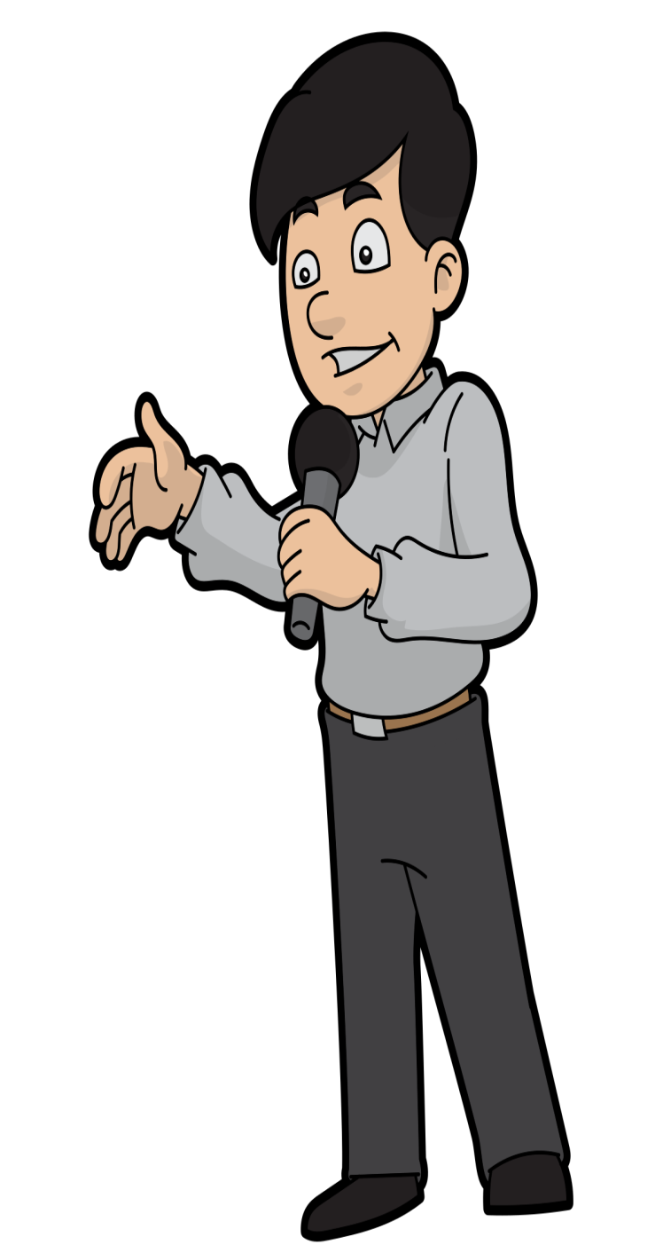
Things You should Do
Eye Contact
Can glance at notes
Appropriate gestures
Rhetorical questions to involve audience

Slide 14
Some Common Barriers
The use of jargon---Over-complicated, unfamiliar and/or technical terms.
Emotional barriers and taboos---Some people may find it difficult to express their emotions and some topics may be completely 'off-limits' or taboo.
Lack of attention, interest, distractions, or irrelevance to the receiver.
Differences in perception and viewpoint.
Physical disabilities such as hearing problems or speech difficulties.

Slide 15
Physical barriers to non-verbal communication---Not being able to see the non-verbal cues, gestures, posture and general body language can make communication less effective.
Language differences and the difficulty in understanding unfamiliar accents.
Expectations and prejudices which may lead to false assumptions or stereotyping. People often hear what they expect to hear rather than what is actually said and jump to incorrect conclusions.
Cultural differences. The norms of social interaction vary greatly in different cultures, as do the way in which emotions are expressed. For example, the concept of personal space varies between cultures and between different social settings.

Slide 16


